Slide 1
Public Procurement & E-Procurement Legal System in KOREA
Dae Sik, Kim
Research Fellow
Korea Institute of Procurement

Slide 2
CONTENTS
■ Public Procurement and Economic Development
■ Short History of Economic Development in Korea
■ E-Public Procurement & Regulation (early stage)
■ KOREA E-Public Procurement Legal System
■ Lessons

Slide 3
Public Procurement and Economic Development
1. Public procurement is frequently used as a method of industrial policy such as strengthening ‘small and medium sized enterprises’ (SME).
2. Public procurement is a basis for establishing social infrastructure such as road, dam, etc.
- Enhancing transparency and efficiency of public procurement can be a strong basis for economic development.

Slide 4
Public Procurement and Economic Development
PPS Contract Statistics
(100 Million Korean Won, %)
Year |  | 2011 | 2012 | 2013 | 2014 | 2015
Total Contract Price (A) |  | 339,812 ($29.6 Billion) | 347,346 (($30.3 Billion) | 383,733 (($33.4 Billion) | 339,479 (($29.6 Billion) | 362,453 (($31.6 Billion)
Big Business | Contract Price (B) |  |  |  | 60,524 (($5.2 Billion) | 55,192 (($4.8 Billion)
 | Ratio (B/A) |  |  |  | 17.9 | 15.3
Medium Business | Contract Price (C) |  |  |  | 32.231 (($2.8 Billion) | 35,386 (($3.0 Billion)
 | Ratio (C/A) |  |  |  | 9.5 | 9.8
Small Business | Contract Price (D) | 224,941 (($19.6 Billion) | 227,549 (($19.8 Billion) | 255,317 (($22.2 Billion) | 242,992 (($21.1 Billion) | 266,866 (($23.2 Billion)
 | Ratio (D/A) | 66.3 | 65.6 | 66.5 | 71.8 | 73.9
Others | Contract Price (E) |  |  |  | 2,682 (($0.2 Billion) | 3,459 (($0.3 Billion)
 | Ratio (E/A) |  |  |  | 0.8 | 1
PPS(KOREA) : About 31.4% of All Public Procurement Asset (Small Business 73.9%)
4

Slide 5
Short History of Economic Development in Korea (1)
1950: ODA (Official Development Assistance) from US
1962-1979: President Park Chung Hee’s Regime
-Focusing on Industrial Policy
-Economic Planning Board
1980-1993: President Choe,Chun & Roh’s Regime
-Focusing on Competition Policy
-Fair Trade Commission

Slide 6
Short History of Economic Development in Korea (2)
1994-present: President Kim and Afterwards
- Boosting IT Industry
- Ministry of Information and Communication
- Financial Supervisory Commission (After Asian Financial Crisis)
Government took a critical role in economic development in Korea.
Public Procurement can be understood in this context.

Slide 7
Short History of Public Procurement Law in Korea (3)
Before Joining the WTO Government Procurement Agreement (GPA) in 1995
As controlling budget is crucial in government procurement, this area was traditionally dealt by public finance law.
This is the reason why government procurement was provided in ‘Public Budget and Accounting Act’ and ‘Local Government Finance Act’.

Slide 8
Short History of Public Procurement Law in Korea (4)
After Joining the WTO Government Procurement Agreement (GPA) in 1995
Independent Statutes on public procurement were enacted.
‘Act on contracts in which the state is a party’ [hereinafter, Central Government Procurement Act (CGPA)] was enacted in 1995, and ‘Act on contracts in which the local government is a party’ [hereinafter, Local Government Procurement Act (LGPA)] was enacted in 2005.

Slide 9
E-Public Procurement & Regulation (early stage) (1)
Korea E-bidding System (GoBIMS) (2000) - Improvement of
Relevant Laws & Systems
Some systems needed to be newly created for the following two reasons.
The first was that there were no existing systems in place. Another was that there were needed some regulations for preventing bidding-related conflicts and ensuring legal stability.
The former includes regulating the confirmation and time of e-Document exchange and clarifying the validity and responsibility of e-Signature based on the Framework Act on Electronic Commerce and Digital Signature Act.
The latter includes regulations on system failure handling and successful bidder declaration.
9

Slide 10
E-Public Procurement & Regulation (early stage) (2)
Korea E-bidding System (GoBIMS) (2000) - Improvement of
Relevant Laws & Systems
- The new regulations adopted in the course of the e-Bidding system development include Stipulations for e-Bidders (Sep. 19. 2000), Stipulations for e-Bidding executives (Nov. 13. 2000), Special guidelines for facility construction e-Bidding (Sep. 28. 2000), Special guidelines for purchase e-Bidding (Oct. 10. 2000).
Stipulations for e-Bidders defines the rights and duties of PPS and bidder(suppliers) in relation to the participation in and use of e-Bidding prior to the commencement of registration on September 20, 2000.
For registration, users are required to undergo an agreement procedure. Stipulations for e-Bidding executives defines the rights and duties of the public institutions and PPS, the system operator, in relation to the co-use of the e-Bidding system. For registration as an e-Bidding executive, officials from public institutions are required to undergo an agreement procedure.
10

Slide 11
E-Public Procurement & Regulation (early stage) (3)
Korea E-bidding System (GoBIMS) (2000) - Improvement of
Relevant Laws & Systems
- The registration of public institutions was commenced after the system was opened in November 2000. Special guidelines for facility and purchase e-Bidding was prepared prior to the formal mock bidding scheduled for the end of October and contains the contents unique to e-Bidding.
- All above regulations have a mutually complementary relationship in the system development. Problems arising from the regulation process are reflected in the system. The system development results are reflected in the regulations to complete the system.
11

Slide 12
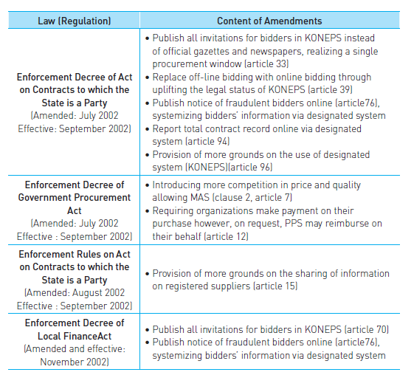
E-Public Procurement & Regulation (early stage) (4)

Slide 13
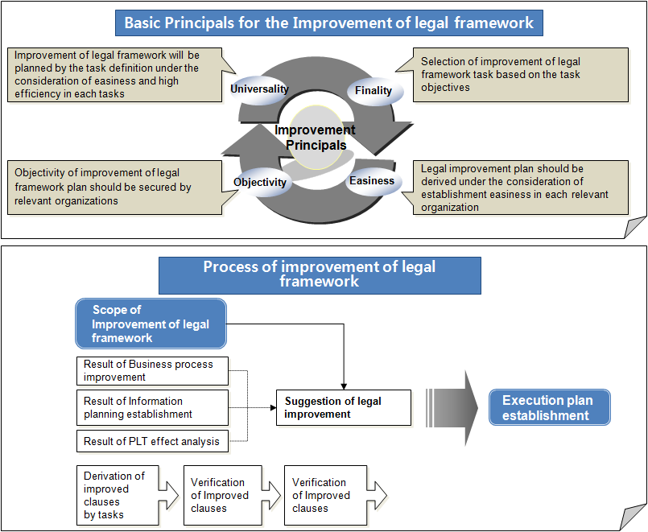
KOREA E-Public Procurement Legal System (1)
Basic improvement principle for laws and regulations

Slide 14
KOREA E-Public Procurement Legal System (2)
Korea’s Laws and Regulations of e-Procurement System
No | Korea’s Laws and Regulations
1 | Enforcement Decree and the Act on contracts with country h the State is a Party
2 | Enforcement Decree of the Act on Contracts to Which a Local Government is a Party
3 | Enforcement Decree of the e-Procurement Utilization and Promotion Act
4 | Enforcement Decree of the Government Procurement Act
5 | Electronic Government Act
6 | Framework Act on Electronic Commerce
7 | Digital Signature Act
8 | Budget and Accounts Act
9 | Personal Information Protection Act
10 | Act on the Management and Use of Information on Commodity Lists
11 | Regulation on National e-Procurement System
12 | Terms and Condition of e-Procurement System Demand Agency
13 | Regulation on Participation Qualification in e-Procurement System Tender
14 | Terms and Condition of e-Procurement System Vendor
15 | Know-how to Treat Contract Office Work Using e-Procurement System
16 | Regulation on Participation Quantification in Tender

Slide 15
KOREA E-Public Procurement Legal System (3)
E-Public Procurement Legal System Approach Process
Bidding
Bid Opening
Contracting
Payment
Infrastructure
Terminology
Definition
Roles &
Responsibilities of
Stakeholder
e-Document
Registration
Process
Security
Process

Slide 16
KOREA E-Public Procurement Legal System (4)
Definition of main item for national integrated e-Procurement system
Criteria | Description
Preparation of legal basis on procedure of procurement tasks, electronically | Preparation of legal basis which is able to deal with procurement tasks such as bidding notice, contract and etc, electronically
Enhancement of e-Procurement’s stability and reliability | Securing of transaction’s stability and reliability by clarifying the point of arrival e-document and effectivation
Preparation of prevention from illegal e-tender | Preparation of penalty basis in case of illegal action on e-Procurement such as counterfeit, falsification, transfer or rental of certification
Inducement of e-Procurement utilization in private sector | Preparation of basis for usage of system by private sector in order to procure goods through the national integrated e-Procurement system

Slide 17
KOREA E-Public Procurement Legal System (5)
<Main contents of The law regarding use and promotion of E-Procurement>
Criteria | Description
General provision | Objective, definition, scope and etc.
Digitalization of procurement tasks | Electronic process, bidding notice, tendering, e-contracting, e-payment of deposit, transmission of e-document
Management and protection of information as to e-Procurement users | Management and provision of information as to contract, user registration of e-Procurement user, privacy protection, prohibition of procurement tasks disturbances, prohibition of illegal e-Procurement behaviors
Support and promotion of e-Procurement tasks | Education and Training as to e-Procurement, international cooperation and export promotion, center for supporting e-Procurement, appointed cancellation of center
Supplementary rules | Fee of using e-Procurement system, payment of reward
Penalty | Penalty, fine and etc.
Criteria | Description

Slide 18
KOREA E-Public Procurement Legal System (6)
Role and Responsibility of Related Parties
Category | Description
Role and responsibility of procurement managing institution | Defines the role and responsibility of procurement managing institution or institution in charge of procurement work. Examples are as follows. - Uses system to reflect requirements to be convenient to execute procurement works. - Collects information required for executing e-Procurement system or procurement work
Role and responsibility of demand agency | Defines the role and responsibility of institutions registered at e-Procurement system to execute procurement works. Examples are as follow. - Registers users in charge of managing the work - Manages users and registered authentications - Installs vaccine program, responsible for security, etc.
Role and responsibility of users in demand agency | Defines the role and responsibility of managers and users in demand agency. Examples are as follow. - Responsible for managing e-signatures - Take actions to loss of e-signature - Confirm the information registered at e-Procurement system - Understands and complies with various regulations regarding to procurement works
Role and responsibility of supplier | Defines the role and responsibility of business operators registered at e-Procurement system. - Responsible for managing e-signatures - Take actions to loss of e-signature - Understands and complies with various regulations regarding to procurement works

Slide 19
KOREA E-Public Procurement Legal System (7)
Laws and Regulations Required for e-Documents
Category | Description
Effectiveness of e-document | e-Documents are the information written, sent, received or stored in an electronic form. This e-Documents should be defined as those paper-based documents.
Storage of e-document | Storage of e-documents should define the followings. - Contents should be readable. - e-Documents should be stored in a format that could be written, sent or received. - Those non-electronic documents can be converted to electronic documents through the system, according to the regulations.
Period and location for e-documents transmittance | Period of e-documents transmittance on e-commerce should be clearly defined since it is very critical contractual point. - e-Documents to be entered into a system in which recipient can receive the related document are considered to be successfully transmitted. - The documents to be entered into designated information system are considered to be successfully transmitted.
Confirmation of receipt | Confirmation of receipt for transmitted e-documents should be clearly defined. - In general, if writer registers the document on defined system, the document considered to be successfully transmitted. However, if writer sends e-document with confirmation of receipt, the documents are not considered to be successfully transmitted until the recipient confirmed the documents.

Slide 20
KOREA E-Public Procurement Legal System (7)
Law and Regulation required for Registration (1)
Category | Details
Registration of demand agency | Defines standards and procedures for registering demand agency on e-Procurement system - Registration location, code grant, certification issuance procedures, Standards for tender participation fee, tender deposit, account registration, etc.
Registration of Manager | Defines registration procedure and standard for e-Procurement system users - Manager: contract manager, tender manager, estimation manager, technical review manager, etc. - Registration of managers and definition of procedure for certified authentication issuance
Tender participation qualification application | Define the bid participation qualification - Criteria on qualification to participate in tender - Definition of disqualification for registration - Definition of uses of registered information - Definition of registration period and effective date - Definition of distribution of tender participation qualification registration card - Scope of tender that registrant eligible to participate - Definition of registration procedure

Slide 21
KOREA E-Public Procurement Legal System (8)
Law and Regulation required for Registration (2)
Category | Details
Product registration | Defines the registration of product - Classification of product registration: manufacturing, supply, etc. - Subject to product registration (manufacturer) - Documents required for product registration (Documents required for registration business registration, a certified copy of corporate register, etc. required by a target country) - Procedure of product registration
Registration of construction and outsourcing service | Defines the registration of construction and product - Subject to registration - Documents required for registration (Documents required for registration business registration, a certified copy of corporate register, etc. required by a target country) - Business type

Slide 22
KOREA E-Public Procurement Legal System (9)
Law and Regulation Required for Security
Category | Details
Protecting personal information | A policy to protect personal information of all e-commerce users should be established and enforced to secure the safety and creditability of e-commerce. - Principle of personal information protection, right of information agent, obligation of nation, etc.
Protecting business confidentiality | A policy to protect business confidentiality of all e-commerce users should be established and enforced to secure the safety and creditability of e-commerce.
Use of coded product | Uses of coded product should be defined to secure the safety and creditability of e-commerce.

Slide 23
KOREA E-Public Procurement Legal System (10)
Legislation and Regulation Related to Tender (1)
Category | Description
Notification of tender | Definition of tender notification - Definition of the notifications through e-Procurement system, daily newspaper, etc.
Time of tender notification | Definition of submission date with consideration for the due date of tender documents - Appropriate time should be defined based on the environment in a target country; different period may be applied upon the project scale.
Details of tender notification | Definition contents to be mentioned in tender notification - Details of project, location and date of tender opening, qualification of participation in tender, determination of successful bidder, beginning and completion of contract, contract terms, etc.
Submission of e-tender | Definition the submission of e-tender proposal and application documents
Application for e-tender cancellation | Definition of contents for the intent of bidder to cancel the tender in event of errors written in critical parts such as amount in e-tender proposal, etc
Participation method of e-tender | Definition of procedures for e-tender participation - Usage of authentication provided by certification authority - Procedure of checking identity - Standard for transmittance of tender proposal and application documents, etc.

Slide 24
KOREA E-Public Procurement Legal System (11)
Legislation and Regulation Related to Tender (2)
Category | Description
Cancellation of Tender | Requirements related to cancellation of tender --In the event of unavoidable reasons such as reduction or change of budget in demand agency, prior to notifying the successful bidder
Re e-tender | Definition of the standards and procedure in case of re-tender
Delayed notification of e-tender | Definition of partially or whole delays in e-tender schedule, including deadline for submission, application deadline, date of tender opening, etc.
Invalidity of Tender | Definition of cases such as disqualified participant in tender
Limitation of improper company’s participation in tender | Standards and definition of company not eligible to participate in tender
Certification authority | Definition of standard for certification authentication work to perform safely and reliably. - Designation of an institute with consideration for standard, procedure, reason for disqualification, etc. - Definition of works related to: authentication management, e-signature generating information management, facility and operations management, etc. - Definition of taking over certificate works - Definition of discard and abolition of certificate works
Certified authentication | Definition of certified authentication's issuance and effectiveness, and etc. - Issuance of certified authentication (including name, verification information, serial number, effective institution, name of certification authority, scope of use and purpose, etc.) - Definition of the lost effectiveness of authentication - Definition of the abolition of authentication

Slide 25
KOREA E-Public Procurement Legal System (12)
Laws and regulations related to tender opening
Category | Description
Opening of e-tender | Definition of the opening of e-tender - Confirmation definition of the participant's ID - Usage of authentication provided by certification authority
Selection of successful bidder | Definition of standards and procedure for selecting successful bidder after opening tender
Determination of successful bidder when same price offered | Definition of case of 2 or more successful bidders when same price offered
Formal objection | Definition of formal objection and procedure as to tender and tender results

Slide 26
KOREA E-Public Procurement Legal System (13)
Laws and Regulations Related to Contract
Category | Description
Conclusion of e-contract | Definition of a contract to be concluded electronically through e-Procurement system - In general, the user prepares the contract in draft to send over to demand agency and then demand agency accept and replay back. The user inputs contract number and date to send it over to demand agency again. When demand agency receives this, that considers as a contract finally concluded.
Change of contract | Definition of the changes in contract already concluded
Contract deposit and performance bond | Definition of the standard and payment procedure as to contract deposit and performance bond by laws in a counterpart country
Compensation of deferment | Definition of the standard and procedure for compensation of deferment to be imposed when contractor delays the obligations stipulated on the contract
Cancellation of contract | Definition as to cancellation in case of contract that is not further conducted by contractor due to his/her attribuTable reason
Contract ethics | Definition of integrity contract to enhance the transparency in procurement administration - Prohibition of requests for money and valuables, collusion or special consideration to select specific party
Violation of integrity contract | Definition of standard and regulations for violation of integrity contract

Slide 27
KOREA E-Public Procurement Legal System (14)
Laws and Regulation related to payment
Category | Description
e-payment of deposit | Definition of the deposit to be paid according to regulations of counterpart country
e-payment for service | Definition of payment to be paid according to regulations of counterpart country
Process of e-payment | Standards and procedure as to payment through the national or private bank

Slide 28
Lessons(1)
Centralized Procurement
Centralized Procurement through PPS enhanced innovation and expertise.
E-procurement is combined with efficient centralized procurement. Many central and local government agencies are using KONEPS which is established by PPS.

Slide 29
Lessons(2)
E-procurement
Balancing between transparency and efficiency is crucial point in developing public procurement regime. E-procurement can be useful tool to achieve both objectives.
In Korea, in the first phase, E-procurement was emphasized as a tool for enhancing transparency (information disclosure), however in the second phase more emphasis was put upon efficiency (Multiple Award Schedule).

Slide 30
Lessons(3)
Government Role in Economic Development
In Korean economic development, the central role of government was crucial. Strengthening SME through public procurement is one example. (East-Asian Development Model)
Liberalization of government market should be harmonized with enhancing SME in each country.

Slide 31
Lessons(4)
Motivation
Preference for new technology products in e-public procurement motivated the innovations in each enterprise.

Slide 32
Lessons(5)
Sub-central government
The Relationship between central government procurement law and sub-central government law should be carefully designed.
There should be sound ground for different legislation of both system.

Slide 33
Lessons(6)
Transparency
In Korea, corruptions in public procurement is not totally eradicated yet.
However, enhanced transparency through e-procurement are diminishing the level of corruption incrementally.
Supreme court decision that public procurement contract as a private contract is criticized.

Slide 34
Lessons(7)
User-Friendly
Act on E-Government Provides that administrative information of government (court decisions, statutes, regulations etc) should be disclosed through internet (Art. 14).
It is emphasized that the information should be disclosed in a way that ordinary citizens can understand easily (user-friendly information disclosure, Art. 3).

Slide 35
Thank You!

